Slide 1
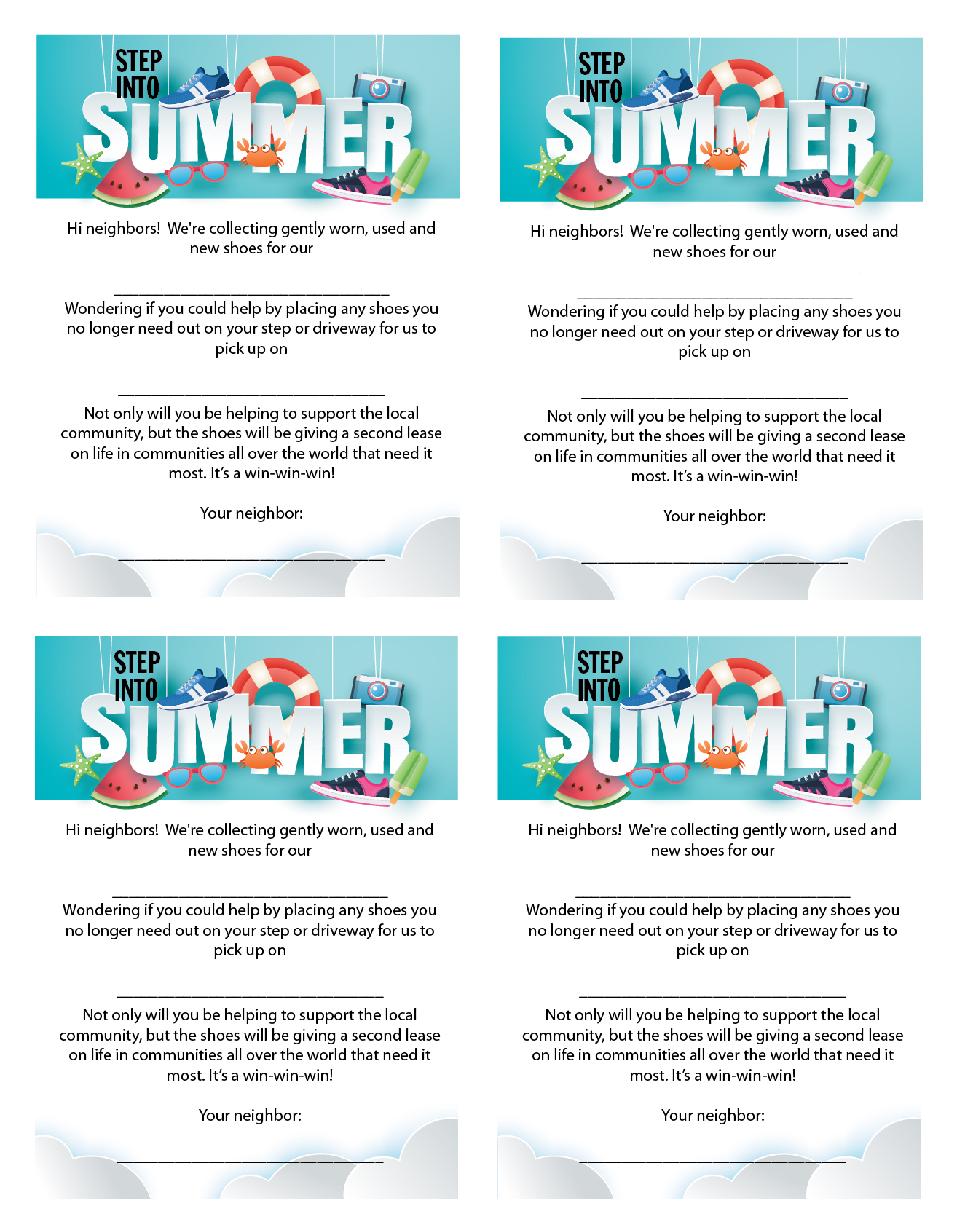
Group Name
Group Name
Location
Location
Your Name
Your Name
Group Name
Group Name
Location
Location
Your Name
Your Name

