Slide 1
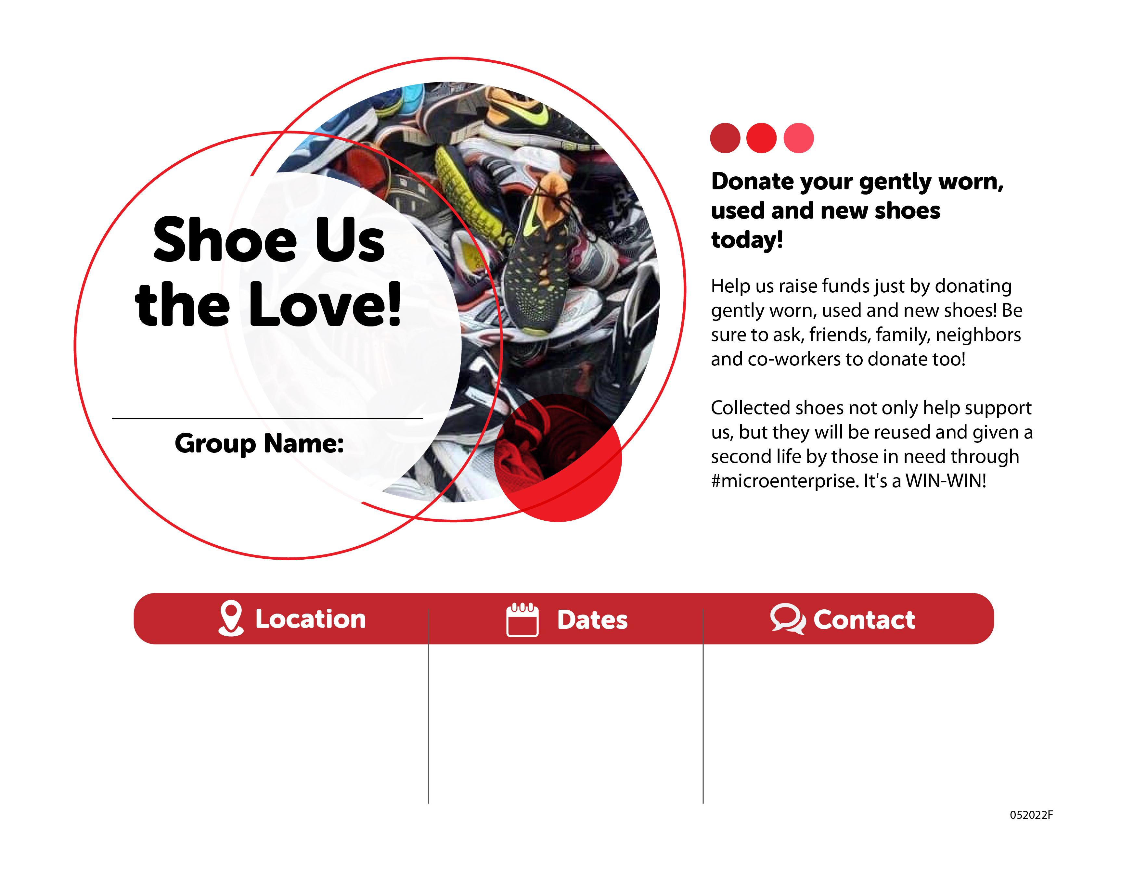
Enter the name of your organization here or delete this box to place your logo in this space.
Drop-off location or information about your event.
Dates and times of your drop-off or event.
Enter your email, phone, etc

