Slide 1
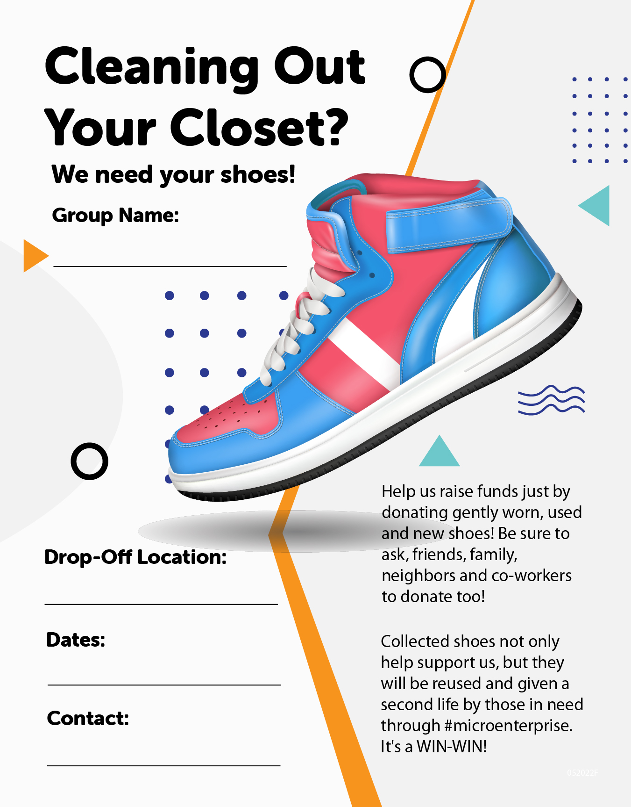
Organization Name
Drop-off location
Dates and times of your event.
Enter your email, phone, etc

